Slide 1
Cryptography and Network Security Overview & Chapter 1
by William Stallings
Notes:
‹#›
‹#›
Lecture slides by Lawrie Brown for “Cryptography and Network Security”, 5/e, by William Stallings, briefly reviewing the text outline from Ch 0, and then presenting the content from Chapter 1 – “Introduction”.

Slide 2
Roadmap
Cryptographic algorithms
symmetric ciphers
asymmetric encryption
hash functions
Mutual Trust
Network Security
Computer Security
Notes:
‹#›
The material in this book is organized into four broad categories:
• Cryptographic algorithms: This is the study of techniques for ensuring the secrecy and/or authenticity of information. The three main areas of study in this category are: 1. symmetric encryption, 2. asymmetric encryption, and 3. cryptographic hash functions, with the related topics of message authentication codes and digital signatures.
• Mutual trust: This is the study of techniques and algorithms for providing mutual trust in two main areas. First, key management and distribution deals with establishing trust in the encryption keys used between two communicating entities. Second, user authentication deals with establish trust in the identity of a communicating partner.
• Network security: This area covers the use of cryptographic algorithms in network protocols and network applications.
• Computer security: In this book, we use this term to refer to the security of computers against intruders (e.g., hackers) and malicious software (e.g., viruses). Typically, the computer to be secured is attached to a network and the bulk of the threats arise from the network.
‹#›

Slide 3
Standards Organizations
National Institute of Standards & Technology (NIST)
Internet Society (ISOC)
International Telecommunication Union Telecommunication Standardization Sector (ITU-T)
International Organization for Standardization (ISO)
RSA Labs (de facto)
Notes:
‹#›
Throughout this book, we describe the most important standards in use or being developed for various aspects of cryptography and
network security. Various organizations have been involved in the development or promotion of these standards including:
• NIST is a U.S. federal agency that deals with measurement science, standards, and technology related to U.S. government use
and to the promotion of U.S. private-sector innovation. Despite its national scope, NIST Federal Information Processing Standards (FIPS) and Special Publications (SP) have a worldwide impact.
• ISOC is a professional membership society with worldwide organizational and individual membership. It provides leadership in addressing issues that confront the future of the Internet and is the organization home for the groups responsible for Internet infrastructure standards, including the Internet Engineering Task Force (IETF) and the Internet Architecture Board (IAB). These organizations develop Internet standards and related specifications, all of which are published as Requests for Comments (RFCs).
• ITU is an international organization within the United Nations System in which governments and the private sector coordinate global telecom networks and services The ITU Telecommunication Standardization Sector (ITU-T) is one of the three sectors of the ITU. ITU-T's mission is the production of standards covering all fields of telecommunications. ITU-T standards are referred to as Recommendations.
• ISO is a worldwide federation of national standards bodies from more than 140 countries, one from each country. ISO is a nongovernmental organization that promotes the development of standardization and related activities with a view to facilitating the international exchange of goods and services, and to developing cooperation in the spheres of intellectual, scientific, technological, and economic activity. ISO's work results in international agreements that are published as International Standards.
‹#›

Slide 4
Chapter 1 – Introduction
The combination of space, time, and strength that must be considered as the basic elements of this theory of defense makes this a fairly complicated matter. Consequently, it is not easy to find a fixed point of departure..
— On War, Carl Von Clausewitz
Notes:
‹#›
‹#›
This quote from the start of Ch 1 reflects a fundamental principle that we must understand the strength of the algorithms we use in order to have a suitable level of security.

Slide 5
Computer Security
the protection afforded to an automated information system in order to attain the applicable objectives of preserving the integrity, availability and confidentiality of information system resources (includes hardware, software, firmware, information/data, and telecommunications)
Notes:
‹#›
‹#›
The NIST Computer Security Handbook [NIST95] defines the term computer security as shown on this slide. This definition introduces three key objectives that are at the heart of computer security as we see on the next slide.

Slide 6
Cyber Security
the protection of information that is stored, transmitted and processed in a networked system of computers, other digital devices, and network devices and transmitted lines including the internet.
Protection encompasses
Confidentiality,
Integrity,
Availability,
Authenticity,
Accountability
Notes:
‹#›
‹#›
The NIST Computer Security Handbook [NIST95] defines the term computer security as shown on this slide. This definition introduces three key objectives that are at the heart of computer security as we see on the next slide.

Slide 7
Subset of Cyber Security
Information Security:
This term referes to preservation of confidentiality, integrity and availability of information.
Network Security
This term refers to protection of networks and their service from unauthorized modification, destruction or disclosure and provision of assurance that the network performs its critical functions correctlyt and there are no harmful side effects.

Slide 8
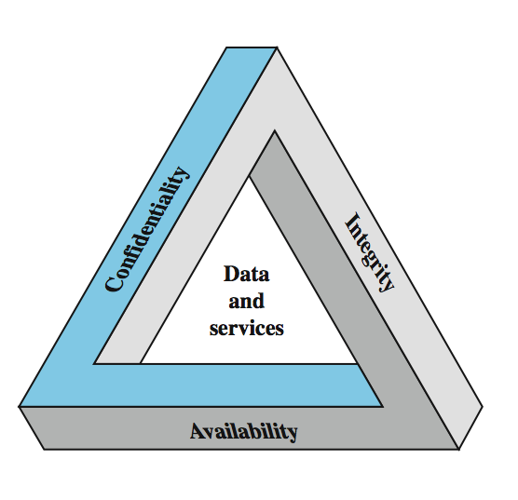
Key Security Concepts
Notes:
‹#›
These three concepts form what is often referred to as the CIA triad (Figure 1.1). The three concepts embody the fundamental security objectives for both data and for information and computing services. FIPS PUB 199 provides a useful characterization of these three objectives in terms of requirements and the definition of a loss of security in each category:
• Confidentiality (covers both data confidentiality and privacy): preserving authorized restrictions on information access and disclosure, including means for protecting personal privacy and proprietary information. A loss of confidentiality is the unauthorized disclosure of information.
• Integrity (covers both data and system integrity): Guarding against improper information modification or destruction, and includes ensuring information non-repudiation and authenticity. A loss of integrity is the unauthorized modification or destruction of information.
• Availability: Ensuring timely and reliable access to and use of information. A loss of availability is the disruption of access to or use of information or an information system.
Although the use of the CIA triad to define security objectives is well established, some in the security field feel that additional concepts are needed to present a complete picture. Two of the most commonly mentioned are:
• Authenticity: The property of being genuine and being able to be verified and trusted; confidence in the validity of a transmission, a message, or message originator.
• Accountability: The security goal that generates the requirement for actions of an entity to be traced uniquely to that entity.
‹#›

Slide 9
Levels of Impact
can define 3 levels of impact from a security breach
Low
Moderate
High
Notes:
‹#›
We can define three levels of impact on organizations or individuals should there be a breach of security (i.e., a loss of confidentiality, integrity, or availability). These levels are defined in FIPS PUB 199:
• Low: The loss could be expected to have a limited adverse effect on organizational operations, organizational assets, or individuals. A limited adverse effect means that, for example, the loss of confidentiality, integrity, or availability might (i) cause a degradation in mission capability to an extent and duration that the organization is able to perform its primary functions, but the effectiveness of the functions is noticeably reduced; (ii) result in minor damage to organizational assets; (iii) result in minor financial loss; or (iv) result in minor harm to individuals.
• Moderate: The loss could be expected to have a serious adverse effect on organizational operations, organizational assets, or individuals. A serious adverse effect means that, for example, the loss might (i) cause a significant degradation in mission capability to an extent and duration that the organization is able to perform its primary functions, but the effectiveness of the functions is significantly reduced; (ii) result in significant damage to organizational assets; (iii) result in significant financial loss; or (iv) result in significant harm to individuals that does not involve loss of life or serious, life-threatening injuries.
• High: The loss could be expected to have a severe or catastrophic adverse effect on organizational operations, organizational assets, or individuals. A severe or catastrophic adverse effect means that, for example, the loss might (i) cause a severe degradation in or loss of mission capability to an extent and duration that the organization is not able to perform one or more of its primary functions; (ii) result in major damage to organizational assets; (iii) result in major financial loss; or (iv) result in severe or catastrophic harm to individuals involving loss of life or serious life threatening injuries.
‹#›

Slide 10
Low Impact
The loss could be expected to have a limited adverse effect on organizational operations, organizational assets, or individuals.
A limited adverse effect means that, for example, the loss of confidentiality, integrity, or availability might
(i) cause a degradation in mission capability to an extent and duration that the organization is able to perform its primary functions, but the effectiveness of the functions is noticeably reduced;
(ii) result in minor damage to organizational assets;
(iii) result in minor financial loss; or
(iv) result in minor harm to individuals.
Notes:
‹#›
We can define three levels of impact on organizations or individuals should there be a breach of security (i.e., a loss of confidentiality, integrity, or availability). These levels are defined in FIPS PUB 199:
• Low: The loss could be expected to have a limited adverse effect on organizational operations, organizational assets, or individuals. A limited adverse effect means that, for example, the loss of confidentiality, integrity, or availability might (i) cause a degradation in mission capability to an extent and duration that the organization is able to perform its primary functions, but the effectiveness of the functions is noticeably reduced; (ii) result in minor damage to organizational assets; (iii) result in minor financial loss; or (iv) result in minor harm to individuals.
• Moderate: The loss could be expected to have a serious adverse effect on organizational operations, organizational assets, or individuals. A serious adverse effect means that, for example, the loss might (i) cause a significant degradation in mission capability to an extent and duration that the organization is able to perform its primary functions, but the effectiveness of the functions is significantly reduced; (ii) result in significant damage to organizational assets; (iii) result in significant financial loss; or (iv) result in significant harm to individuals that does not involve loss of life or serious, life-threatening injuries.
• High: The loss could be expected to have a severe or catastrophic adverse effect on organizational operations, organizational assets, or individuals. A severe or catastrophic adverse effect means that, for example, the loss might (i) cause a severe degradation in or loss of mission capability to an extent and duration that the organization is not able to perform one or more of its primary functions; (ii) result in major damage to organizational assets; (iii) result in major financial loss; or (iv) result in severe or catastrophic harm to individuals involving loss of life or serious life threatening injuries.
‹#›

Slide 11
Moderate Impact
The loss could be expected to have a serious adverse effect on organizational operations, assets, or individuals.
A serious adverse effect means that, e.g., the loss might
(i) cause a significant degradation in mission capability to an extent and duration that the organization is able to perform its primary functions, but the effectiveness of the functions is significantly reduced;
(ii) result in significant damage to organizational assets;
(iii) result in significant financial loss; or
(iv) result in significant harm to individuals that does not involve loss of life or serious, life-threatening injuries.
Notes:
‹#›
We can define three levels of impact on organizations or individuals should there be a breach of security (i.e., a loss of confidentiality, integrity, or availability). These levels are defined in FIPS PUB 199:
• Low: The loss could be expected to have a limited adverse effect on organizational operations, organizational assets, or individuals. A limited adverse effect means that, for example, the loss of confidentiality, integrity, or availability might (i) cause a degradation in mission capability to an extent and duration that the organization is able to perform its primary functions, but the effectiveness of the functions is noticeably reduced; (ii) result in minor damage to organizational assets; (iii) result in minor financial loss; or (iv) result in minor harm to individuals.
• Moderate: The loss could be expected to have a serious adverse effect on organizational operations, organizational assets, or individuals. A serious adverse effect means that, for example, the loss might (i) cause a significant degradation in mission capability to an extent and duration that the organization is able to perform its primary functions, but the effectiveness of the functions is significantly reduced; (ii) result in significant damage to organizational assets; (iii) result in significant financial loss; or (iv) result in significant harm to individuals that does not involve loss of life or serious, life-threatening injuries.
• High: The loss could be expected to have a severe or catastrophic adverse effect on organizational operations, organizational assets, or individuals. A severe or catastrophic adverse effect means that, for example, the loss might (i) cause a severe degradation in or loss of mission capability to an extent and duration that the organization is not able to perform one or more of its primary functions; (ii) result in major damage to organizational assets; (iii) result in major financial loss; or (iv) result in severe or catastrophic harm to individuals involving loss of life or serious life threatening injuries.
‹#›

Slide 12
High Impact
The loss could be expected to have a severe or catastrophic adverse effect on organizational operations, organizational assets, or individuals.
A severe or catastrophic adverse effect means that, for example, the loss might
(i) cause a severe degradation in or loss of mission capability to an extent and duration that the organization is not able to perform one or more of its primary functions;
(ii) result in major damage to organizational assets;
(iii) result in major financial loss; or
(iv) result in severe or catastrophic harm to individuals involving loss of life or serious life threatening injuries.
Notes:
‹#›
We can define three levels of impact on organizations or individuals should there be a breach of security (i.e., a loss of confidentiality, integrity, or availability). These levels are defined in FIPS PUB 199:
• Low: The loss could be expected to have a limited adverse effect on organizational operations, organizational assets, or individuals. A limited adverse effect means that, for example, the loss of confidentiality, integrity, or availability might (i) cause a degradation in mission capability to an extent and duration that the organization is able to perform its primary functions, but the effectiveness of the functions is noticeably reduced; (ii) result in minor damage to organizational assets; (iii) result in minor financial loss; or (iv) result in minor harm to individuals.
• Moderate: The loss could be expected to have a serious adverse effect on organizational operations, organizational assets, or individuals. A serious adverse effect means that, for example, the loss might (i) cause a significant degradation in mission capability to an extent and duration that the organization is able to perform its primary functions, but the effectiveness of the functions is significantly reduced; (ii) result in significant damage to organizational assets; (iii) result in significant financial loss; or (iv) result in significant harm to individuals that does not involve loss of life or serious, life-threatening injuries.
• High: The loss could be expected to have a severe or catastrophic adverse effect on organizational operations, organizational assets, or individuals. A severe or catastrophic adverse effect means that, for example, the loss might (i) cause a severe degradation in or loss of mission capability to an extent and duration that the organization is not able to perform one or more of its primary functions; (ii) result in major damage to organizational assets; (iii) result in major financial loss; or (iv) result in severe or catastrophic harm to individuals involving loss of life or serious life threatening injuries.
‹#›

Slide 13
Examples of Security Requirements
confidentiality – student grades
integrity – patient information
availability – authentication service
authenticity – admission ticket
non-repudiation – stock sell order
Notes:
‹#›
We now provide some examples of applications that illustrate the requirements just enumerated.
• Confidentiality - Student grade information is an asset whose confidentiality is considered to be highly important by students. Grade information should only be available to students, their parents, and employees that require the information to do their job. Student enrollment information may have a moderate confidentiality rating. While still coveredby FERPA, this information is seen by more people on a daily basis, is less likely to be targeted than grade information, and results in less damage if disclosed. Directory information, such as lists of students or faculty or departmental lists, may be assigned a low confidentiality rating or indeed no rating. This information is typically freely available to the public and published on a school's Web site.
• Integrity – Consider a hospital patient's allergy information stored in a database. The doctor should be able to trust that the information is correct and current. Now suppose that an employee (e.g., a nurse) who is authorized to view and update this information deliberately falsifies the data to cause harm to the hospital. The database needs to be restored to a trusted basis quickly, and it should be possible to trace the error back to the person responsible. Patient allergy information is an example of an asset with a high requirement for integrity. Inaccurate information could result in serious harm or death to a patient and expose the hospital to massive liability.
• Availability - The more critical a component or service, the higher is the level of availability required. Consider a system that provides authentication services for critical systems, applications, and devices. An interruption of service results in the inability for customers to access computing resources and staff to access the resources they need to perform critical tasks. The loss of the service translates into a large financial loss in lost employee productivity and potential customer loss.
‹#›

Slide 14
Computer Security Challenges
not simple – easy to get it wrong
must consider potential attacks
procedures used counter-intuitive
involve algorithms and secret info
must decide where to deploy mechanisms
battle of wits between attacker / admin
not perceived to be of benefit until it fails
requires regular monitoring
a process, not an event
too often an after-thought
regarded as impediment to using system
“Unusable security is not secure”
Notes:
‹#›
Computer security is both fascinating and complex. Some of the reasons follow:
1. Computer security is not as simple as it might first appear to the novice. The requirements seem to be straightforward, but the mechanisms used to meet those requirements can be quite complex and subtle.
2. In developing a particular security mechanism or algorithm, one must always consider potential attacks (often unexpected) on those security features.
3. Hence procedures used to provide particular services are often counterintuitive.
4. Having designed various security mechanisms, it is necessary to decide where to use them.
5. Security mechanisms typically involve more than a particular algorithm or protocol, but also require participants to have secret information, leading to issues of creation, distribution, and protection of that secret information.
6. Computer security is essentially a battle of wits between a perpetrator who tries to find holes and the designer or administrator who tries to close them.
7. There is a natural tendency on the part of users and system managers to perceive little benefit from security investment until a security failure occurs.
8. Security requires regular monitoring, difficult in today's short-term environment.
9. Security is still too often an afterthought - incorporated after the design is complete.
10. Many users / security administrators view strong security as an impediment to efficient and user-friendly operation of an information system or use of information.
‹#›

Slide 15

OSI Security Architecture
ITU-T X.800 “Security Architecture for OSI”
defines a systematic way of defining and providing security requirements
for us it provides a useful, if abstract, overview of concepts we will study
Notes:
‹#›
‹#›
To assess effectively the security needs of an organization and to evaluate and choose various security products and policies, the manager responsible for security needs some systematic way of defining the requirements for security and characterizing the approaches to satisfying those requirements. This is difficult enough in a centralized data processing environment; with the use of local and wide area networks the problems are compounded. ITU-T Recommendation X.800, Security Architecture for OSI, defines such a systematic approach. The OSI security architecture is useful to managers as a way of organizing the task of providing security.

Slide 16
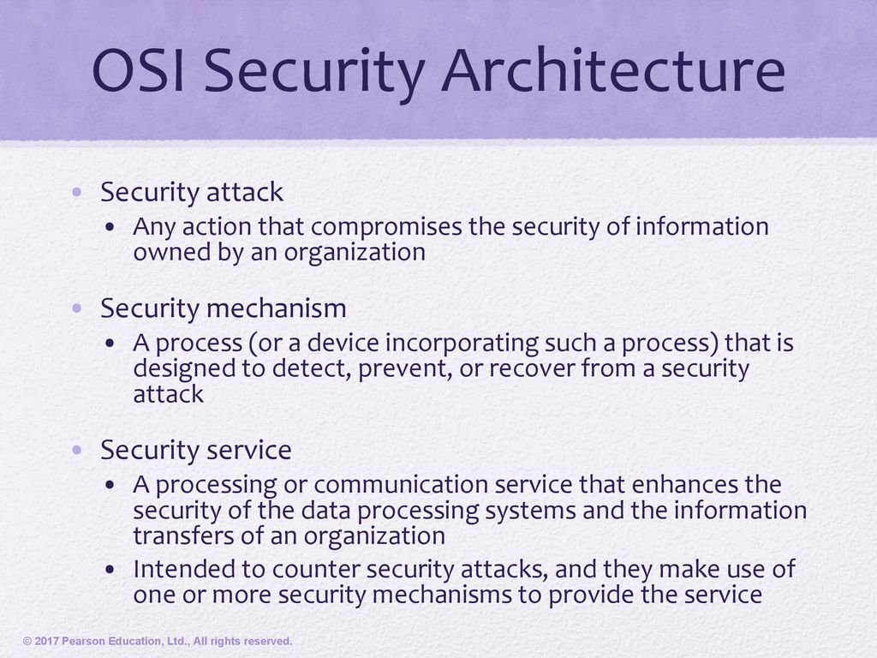

Slide 17
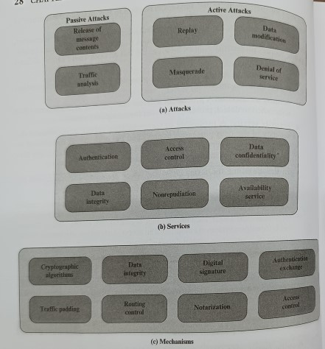

Slide 18
Aspects of Security
consider 3 aspects of information security:
security attack
security mechanism (control)
security service
note terms
threat – a potential for violation of security
vulnerability – a way by which loss can happen
attack – an assault on system security, a deliberate attempt to evade security services
Notes:
‹#›
‹#›
The OSI security architecture focuses on security attacks, mechanisms, and services. These can be defined briefly as follows:
• Security attack: Any action that compromises the security of information owned by an organization.
• Security mechanism: A process (or a device incorporating such a process) that is designed to detect, prevent, or recover from a security attack.
• Security service: A processing or communication service that enhances the security of the data processing systems and the information transfers of an organization. The services are intended to counter security attacks, and they make use of one or more security mechanisms to provide the service.
In the literature, the terms threat and attack are commonly used to mean more or less the same thing. Table 1.1 provides definitions taken from RFC 2828, Internet Security Glossary.
Threat - A potential for violation of security, which exists when there is a circumstance, capability, action, or event that could breach security and cause harm. That is, a threat is a possible danger that might exploit a vulnerability.
Attack - An assault on system security that derives from an intelligent threat; that is, an intelligent act that is a deliberate attempt (especially in the sense of a method or technique) to evade security services and violate the security policy of a system.

Slide 19
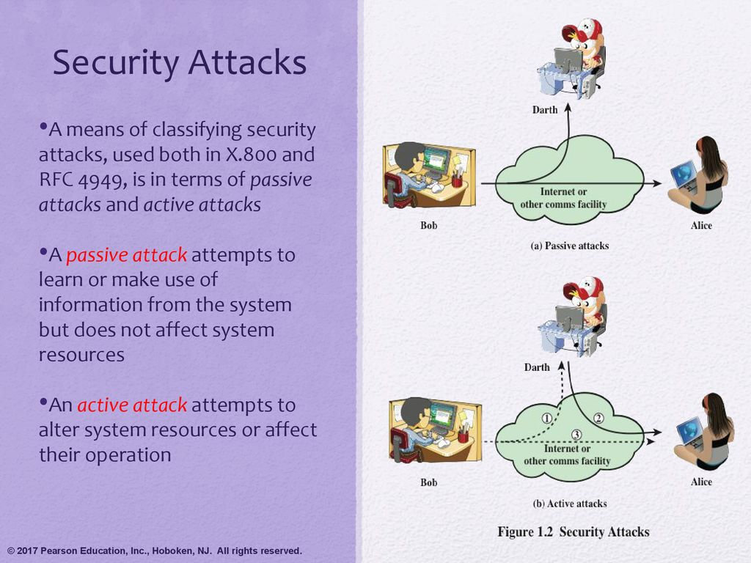

Slide 20
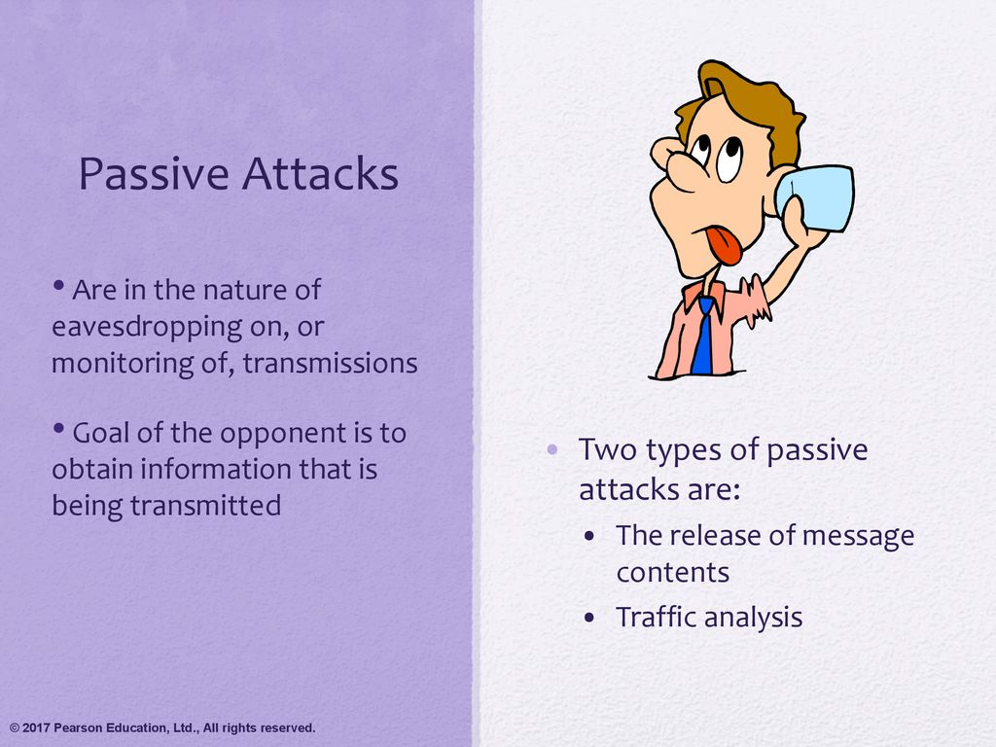

Slide 21
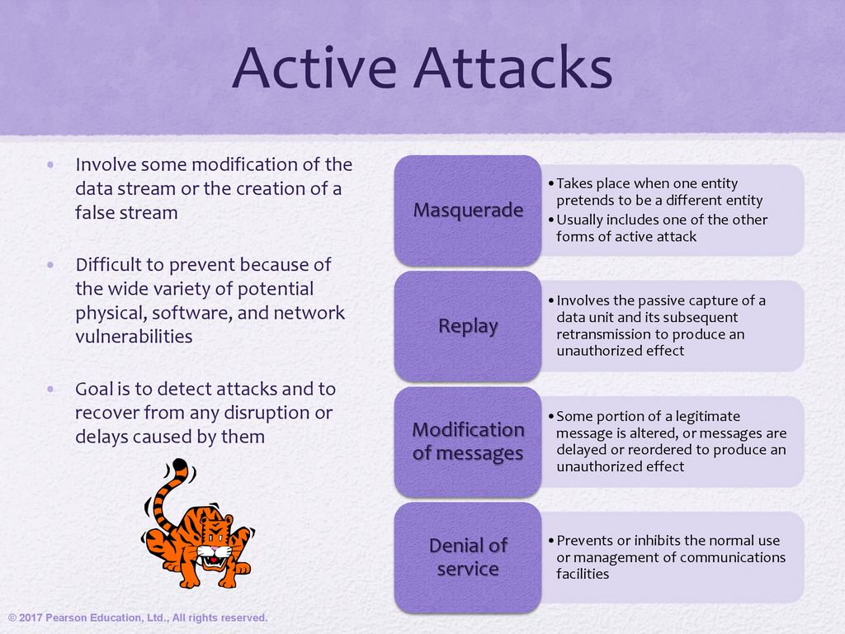

Slide 22
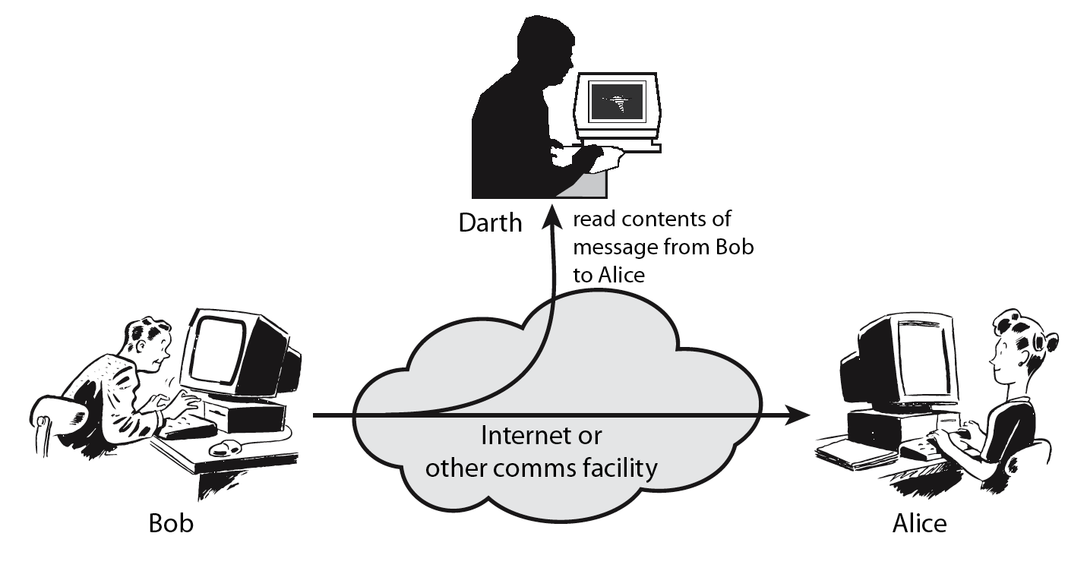
Passive Attack - Interception
Interception: It's like someone secretly eavesdropping on your phone call.
Notes:
‹#›
‹#›
A useful means of classifying security attacks, used both in X.800 and RFC 2828, is in terms of passive attacks and active attacks. A passive attack attempts to learn or make use of information from the system but does not affect system resources.
Passive attacks are in the nature of eavesdropping on, or monitoring of, transmissions. The goal of the opponent is to obtain information that is being transmitted. Two types of passive attacks are:
+ release of message contents - as shown above in Stallings Figure 1.2a here
+ traffic analysis - monitor traffic flow to determine location and identity of communicating hosts and could observe the frequency and length of messages being exchanged
These attacks are difficult to detect because they do not involve any alteration of the data.

Slide 23
Interception -Passive Attack
Interception is when an unauthorized person listens to or captures the communication between two parties. The attacker is trying to gather sensitive information like passwords, messages, or credit card numbers.
Example:
Imagine Bob sends Alice an email containing his account details. An attacker, Darth, intercepts the email using tools like packet sniffers (e.g., Wireshark) and reads the sensitive information.
Alice and Bob won’t even know their communication was intercepted because Darth didn’t modify it.

Slide 24
Passive Attack: Traffic Analysis
Observe traffic pattern
Traffic Analysis: It's like someone watching how often and how long you make calls without hearing the actual conversation.
Notes:
‹#›
‹#›
A useful means of classifying security attacks, used both in X.800 and RFC 2828, is in terms of passive attacks and active attacks. A passive attack attempts to learn or make use of information from the system but does not affect system resources.
Passive attacks are in the nature of eavesdropping on, or monitoring of, transmissions. The goal of the opponent is to obtain information that is being transmitted. Two types of passive attacks are:
+ release of message contents - as shown above in Stallings Figure 1.2a here
+ traffic analysis - monitor traffic flow to determine location and identity of communicating hosts and could observe the frequency and length of messages being exchanged
These attacks are difficult to detect because they do not involve any alteration of the data.

Slide 25
2. Traffic Analysis -Passive Attack
Traffic analysis is about monitoring the patterns of communication rather than the content. The attacker focuses on when communication happens, how frequently, or between which parties, to infer useful information.
Example:
Bob works in a secret organization. Even though Darth cannot decrypt Bob’s encrypted messages to Alice, Darth notices that Bob sends a lot of data to Alice at 10 AM every day. Darth might deduce that something significant happens at that time, like sending daily reports or sensitive updates.

Slide 26
Active Attacks
In cryptography, active attacks involve directly interfering with communication to alter, disrupt, or manipulate data. These are more aggressive than passive attacks because the attacker actively modifies or fabricates data. Common types of active attacks include interruption, fabrication, replay, and modification.

Slide 27
Active Attack: Interruption
Block delivery of message
Notes:
‹#›
‹#›
A useful means of classifying security attacks, used both in X.800 and RFC 2828, is in terms of passive attacks and active attacks. A passive attack attempts to learn or make use of information from the system but does not affect system resources.
Passive attacks are in the nature of eavesdropping on, or monitoring of, transmissions. The goal of the opponent is to obtain information that is being transmitted. Two types of passive attacks are:
+ release of message contents - as shown above in Stallings Figure 1.2a here
+ traffic analysis - monitor traffic flow to determine location and identity of communicating hosts and could observe the frequency and length of messages being exchanged
These attacks are difficult to detect because they do not involve any alteration of the data.

Slide 28
1. Interruption - Active Attacks
Interruption is when an attacker disrupts the communication, making data or services unavailable to the intended recipient.
Example:
Real-life analogy: Imagine someone cuts a telephone wire between Alice and Bob so they can no longer communicate.
In cybersecurity: A Denial of Service (DoS) attack is an example of interruption, where a server is overwhelmed with fake requests, making it unavailable to legitimate users.
Prevention:
Use redundancy in systems and backup servers to ensure availability.
Implement firewalls and intrusion detection systems (IDS).

Slide 29
Active Attack: Fabrication
Fabricate message
Notes:
‹#›
‹#›
A useful means of classifying security attacks, used both in X.800 and RFC 2828, is in terms of passive attacks and active attacks. A passive attack attempts to learn or make use of information from the system but does not affect system resources.
Passive attacks are in the nature of eavesdropping on, or monitoring of, transmissions. The goal of the opponent is to obtain information that is being transmitted. Two types of passive attacks are:
+ release of message contents - as shown above in Stallings Figure 1.2a here
+ traffic analysis - monitor traffic flow to determine location and identity of communicating hosts and could observe the frequency and length of messages being exchanged
These attacks are difficult to detect because they do not involve any alteration of the data.

Slide 30
2. Fabrication- Active Attacks
Fabrication is when an attacker creates fake data or messages and sends them as if they came from a legitimate source.
Example:
Real-life analogy: Eve sends Bob a fake email pretending to be Alice, asking for sensitive information like a password.
In cybersecurity: A phishing attack is a form of fabrication where attackers create fake login pages or emails to deceive users.
Prevention:
Implement digital signatures to verify the authenticity of messages.
Train users to recognize phishing and other deceptive practices.

Slide 31
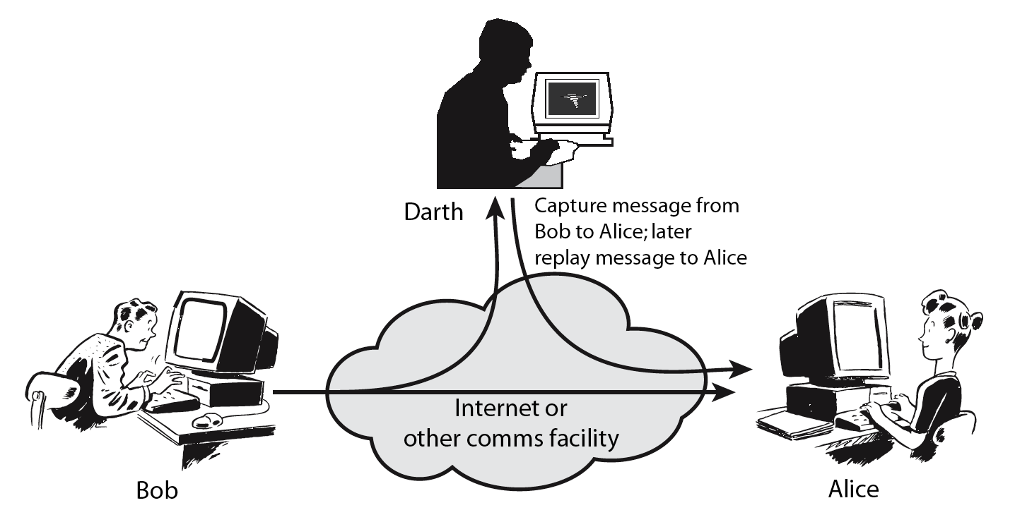
Active Attack: Replay
Notes:
‹#›
‹#›
Active attacks involve some modification of the data stream or the creation of a false stream and can be subdivided into four categories: masquerade, replay, modification of messages, and denial of service:
masquerade of one entity as some other
replay previous messages (as shown above in Stallings Figure 1.3b)
modify/alter (part of) messages in transit to produce an unauthorized effect
denial of service - prevents or inhibits the normal use or management of communications facilities
Active attacks present the opposite characteristics of passive attacks. Whereas passive attacks are difficult to detect, measures are available to prevent their success. On the other hand, it is quite difficult to prevent active attacks absolutely, because of the wide variety of potential physical, software, and network vulnerabilities. Instead, the goal is to detect active attacks and to recover from any disruption or delays caused by them.

Slide 32
3. Replay- Active Attacks
In a replay attack, the attacker captures legitimate communication and later retransmits it to trick the recipient into thinking it’s a new transaction.
Example:
Real-life analogy: Eve overhears Alice giving Bob an authorization code and uses it later to access Bob’s account without Alice's knowledge.
In cybersecurity: Eve intercepts a payment authorization token from Alice to Bob and uses it to make an unauthorized transaction.
Prevention:
Use time stamps and nonces (random unique numbers) to ensure that messages are used only once.
Employ secure protocols like TLS to encrypt and validate messages.

Slide 33
Active Attack: Modification
Modify message
Notes:
‹#›
‹#›
Active attacks involve some modification of the data stream or the creation of a false stream and can be subdivided into four categories: masquerade, replay, modification of messages, and denial of service:
masquerade of one entity as some other
replay previous messages (as shown above in Stallings Figure 1.3b)
modify/alter (part of) messages in transit to produce an unauthorized effect
denial of service - prevents or inhibits the normal use or management of communications facilities
Active attacks present the opposite characteristics of passive attacks. Whereas passive attacks are difficult to detect, measures are available to prevent their success. On the other hand, it is quite difficult to prevent active attacks absolutely, because of the wide variety of potential physical, software, and network vulnerabilities. Instead, the goal is to detect active attacks and to recover from any disruption or delays caused by them.

Slide 34
4. Modification- Active Attacks
Modification is when an attacker alters the content of a legitimate message during transmission.
Example:
Real-life analogy: Alice writes a check to Bob for $100, but Eve changes the amount to $1000 before Bob cashes it.
In cybersecurity: An attacker intercepts a file being sent over the network and modifies it before it reaches the recipient.
Prevention:
Use strong cryptographic hashing (e.g., SHA-256) to detect tampering.
Employ message authentication codes (MACs) to validate data integrity.

Slide 35
Handling Attacks
Passive attacks – focus on Prevention
Easy to stop
Hard to detect
Active attacks – focus on Detection and Recovery
Hard to stop
Easy to detect
Notes:
‹#›
‹#›
Consider the role of a security service, and what may be required.
Note both similarities and differences with traditional paper documents, which for example:
have signatures & dates;
need protection from disclosure, tampering, or destruction;
may be notarized or witnessed;
may be recorded or licensed

Slide 36
Security Service
enhance security of data processing systems and information transfers of an organization
intended to counter security attacks
using one or more security mechanisms
often replicates functions normally associated with physical documents
which, for example, have signatures, dates; need protection from disclosure, tampering, or destruction; be notarized or witnessed; be recorded or licensed
Notes:
‹#›
‹#›
Consider the role of a security service, and what may be required.
Note both similarities and differences with traditional paper documents, which for example:
have signatures & dates;
need protection from disclosure, tampering, or destruction;
may be notarized or witnessed;
may be recorded or licensed

Slide 37
Security Services
X.800:
“a service provided by a protocol layer of communicating open systems, which ensures adequate security of the systems or of data transfers”
RFC 2828:
“a processing or communication service provided by a system to give a specific kind of protection to system resources”
Notes:
‹#›
‹#›
State here a couple of definitions of “security services” from relevant standards. X.800 defines a security service as a service provided by a protocol layer of communicating open systems, which ensures adequate security of the systems or of data transfers. Perhaps a clearer definition is found in RFC 2828, which provides the following definition: a processing or communication service that is provided by a system to give a specific kind of protection to system resources; security services implement security policies and are implemented by security mechanisms.

Slide 38
Security Services (X.800)
Authentication - assurance that communicating entity is the one claimed
have both peer-entity & data origin authentication
Access Control - prevention of the unauthorized use of a resource
Data Confidentiality –protection of data from unauthorized disclosure
Data Integrity - assurance that data received is as sent by an authorized entity
Non-Repudiation - protection against denial by one of the parties in a communication
Availability – resource accessible/usable
Notes:
‹#›
‹#›
This list is taken from Stallings Table 1.2 which provides details of the 5 Security Service categories and the 14 specific services given in X.800.
This list includes the various "classic" security services which are traditionally discussed. Note there is a degree of ambiguity as to the meaning of these terms, and overlap in their use. The broad service categories are:
authentication is concerned with assuring that a communication is authentic. Two specific authentication services are defined in X.800: Peer entity authentication: provides corroboration of the identity of a peer entity in an association; and Data origin authentication: provides corroboration of the source of a data unit.
access control is the ability to limit and control the access to host systems and applications via communications links.
confidentiality is the protection of transmitted data from passive attacks, and the protection of traffic flow from analysis.
integrity assures that messages are received as sent, with no duplication, insertion, modification, reordering, replay, or loss.
availability is the property of a system / resource being accessible and usable upon demand by an authorized system entity, according to performance specifications for the system.

Slide 39
Security Mechanism
a.k.a. control
feature designed to detect, prevent, or recover from a security attack
no single mechanism that will support all services required
however one particular element underlies many of the security mechanisms in use:
cryptographic techniques
hence our focus on this topic
Notes:
‹#›
‹#›
Now introduce “Security Mechanism” which are the specific means of implementing one or more security services. Note these mechanisms span a wide range of technical components, but one aspect seen in many is the use of cryptographic techniques.

Slide 40
Security Mechanisms (X.800)
specific security mechanisms:
encipherment, digital signatures, access controls, data integrity, authentication exchange, traffic padding, routing control, notarization
pervasive security mechanisms:
trusted functionality, security labels, event detection, security audit trails, security recovery
Notes:
‹#›
‹#›
Some examples of mechanisms from X.800. Note that the “specific security mechanisms” are protocol layer specific, whilst the “pervasive security mechanisms” are not. We will meet some of these mechanisms in much greater detail later.
See Stallings Table 1.3 for details of these mechanisms in X.800, and Table 1.4 for the relationship between services and mechanisms.

Slide 41
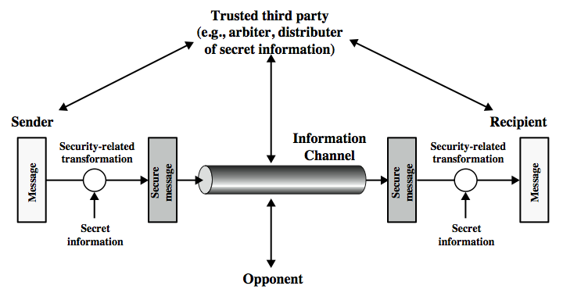
Model for Network Security
Notes:
‹#›
‹#›
In considering the place of encryption, its useful to use the following two models from Stallings section 1.6.
The first, illustrated in Figure 1.4, models information being transferred from one party to another over an insecure communications channel, in the presence of possible opponents. The two parties, who are the principals in this transaction, must cooperate for the exchange to take place. They can use an appropriate security transform (encryption algorithm), with suitable keys, possibly negotiated using the presence of a trusted third party. Parts One through Four of this book concentrates on the types of security mechanisms and services that fit into the model shown here.

Slide 42
Model for Network Security
using this model requires us to:
design a suitable algorithm for the security transformation
generate the secret information (keys) used by the algorithm
develop methods to distribute and share the secret information
specify a protocol enabling the principals to use the transformation and secret information for a security service
Notes:
‹#›
‹#›
This general model shows that there are four basic tasks in designing a particular security service, as listed.

Slide 43
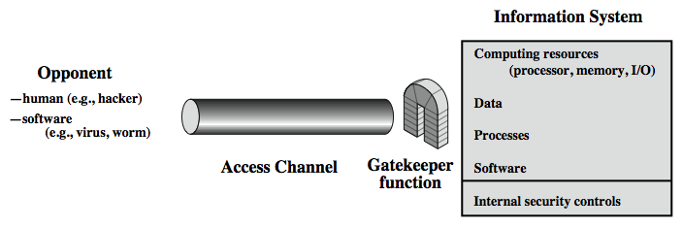
Model for Network Access Security
Notes:
‹#›
‹#›
The second, illustrated in Figure 1.5, model is concerned with controlled access to information or resources on a computer system, in the presence of possible opponents. Here appropriate controls are needed on the access to and within the system, to provide suitable security.
The security mechanisms needed to cope with unwanted access fall into two broad categories (as shown in this figure). The first category might be termed a gatekeeper function. It includes password-based login procedures that are designed to deny access to all but authorized users and screening logic that is designed to detect and reject worms, viruses, and other similar attacks. Once either an unwanted user or unwanted software gains access, the second line of defense consists of a variety of internal controls that monitor activity and analyze stored information in an attempt to detect the presence of unwanted intruders. These issues are explored in Part Four.

Slide 44
Model for Network Access Security
using this model requires us to:
select appropriate gatekeeper functions to identify users
implement security controls to ensure only authorised users access designated information or resources
note that model does not include:
monitoring of system for successful penetration
monitoring of authorized users for misuse
audit logging for forensic uses, etc.
Notes:
‹#›
‹#›
Detail here the tasks needed to use this model.

Slide 45
Summary
topic roadmap & standards organizations
security concepts:
confidentiality, integrity, availability
X.800 security architecture
security attacks, services, mechanisms
models for network (access) security
Notes:
‹#›
‹#›
Chapter 1 summary.

